Slide 1


Baseball I
Produced by Dr. Mario | UNC STOR 390

Slide 2

Overview of Baseball

Slide 3
History of Sabermetrics
Society of American Baseball Research (SABR)
August 10, 1971 in Cooperstown, NY
Founded by Bob Davids
16 Original “Statihistorians”
Publication: Baseball Research Journal
Yearly Dues: $65 (Standard) or $25 (Student)
Objectives of SABR
To foster the study of baseball as a significant American social and athletic institution.
To establish an accurate historical account of baseball through the years.
To facilitate the dissemination of baseball research information.
To stimulate the best interests of baseball as our national pastime.
To cooperate in safeguarding the propietary interests of individual research efforts of members of the Society.

Slide 4
History of Sabermetrics
Bill James
Author and Researcher Focused on Baseball
Publication: Baseball Abstracts (Annual Since 1977)
Term Coined in 1980: “Saber” = “SABR”
Sabermetrics Is the Search for Objective Knowledge About Baseball
One of Time Magazines 100 Most Influential (2006
Sabermetrics
Using Mathematics and Statistics to Understand Baseball
Development of Advanced Metrics to Measure Performance
Textbooks by Gabriel Costa, Michael Huber, and John Saccoman
Understanding Sabermetrics (2008)
Practicing Sabermetrics (2009)

Slide 5
History of Sabermetrics
Moneyball: The Art of Winning an Unfair Game
Authored by Michael Lewis (2003)
About Oakland Athletics MLB Season in 2002
General Manager Billy Beane
Finished with the Same Number of Wins as New York Yankees
Payroll Difference: $44M to $125M
Statistical Analyses Proved Flaws in Classic Statistics
Identified Undervalued Players Using Different Metrics such as On-Base Percentage
Used Statistics to Modify Playing Style (Devaluation of Steals)

Slide 6

History of Sabermetrics

Slide 7
History of Sabermetrics
Jim Albert
Statistics Professor at Bowling Green State University
Sabermetrics: The Past, The Present, and The Future (2010)
Analyzing Baseball Data with R: (2014)
Useful Websites
www.baseballprospectus.com
www.hardballtimes.com
www.retrosheet.org
Free Data Sources
Lahman Database
Retrosheet
PITCH F/X

Slide 8



Classic and Modern Metrics
H = Hit
AB = At-bat
BB = Walk
HBP = Hit by Pitch
SF = Sacrifice Fly
S = Single
D = Double
T = Triple
HR = Home Run
Measuring Batting
Batting Average (AVG)
On-base Percentage (OBP)
Slugging Percentage (SLG)
OPS
$$AVG= \frac{H}{AB}$$
$$OBP= \frac{H+BB+HBP}{AB+BB+HBP+SF}$$
$$SLG= \frac{S+2D+3T+4HR}{AB}$$
$$OPS=OBP+SLG$$

Slide 9
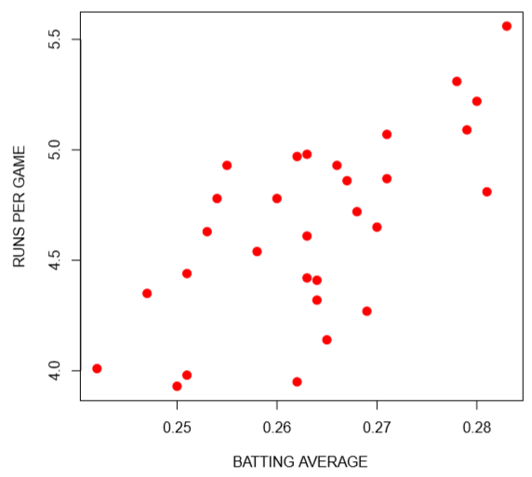
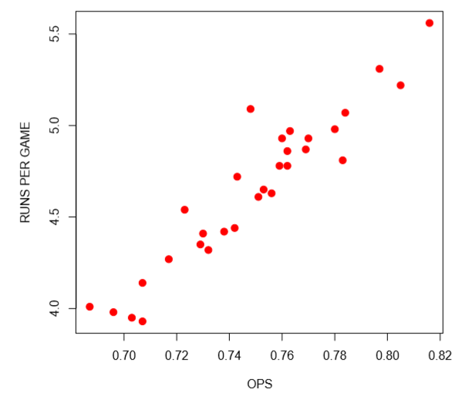
Classic and Modern Metrics
H = Hit
AB = At-bat
BB = Walk
HBP = Hit by Pitch
SF = Sacrifice Fly
S = Single
D = Double
T = Triple
R = Run
G = Game
Measuring Batting
Runs Per Game (R/G)

Slide 10




Classic and Modern Metrics
W = Win
L = Loss
ER = Earned Run
IP = Innings
K = Strikeout
HR =Home Run
BB = Walk
HBP = Hit by Pitch
Measuring Pitching
Win Percentage (WIN%)
Earned Run Average (ERA)
Strikeout Rate (K/9)
Defense-Independent Pitching Statistic (DIPS)
DICE
$$WIN\%= \frac{W}{W+L}$$
$$ERA=9×\frac{ER}{IP}$$
$$K/9=9×\frac{K}{IP}$$
$$DICE=3+\frac{13×HR+3\left(BB×HBP\right)−2×K}{IP}$$

Slide 11
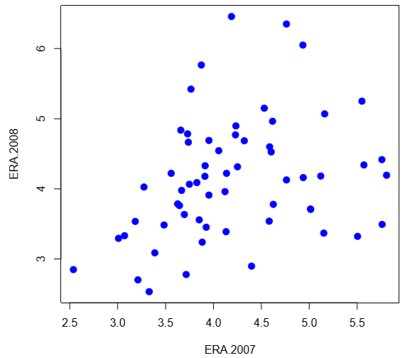
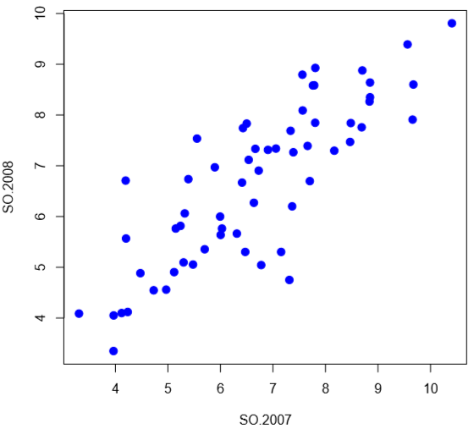
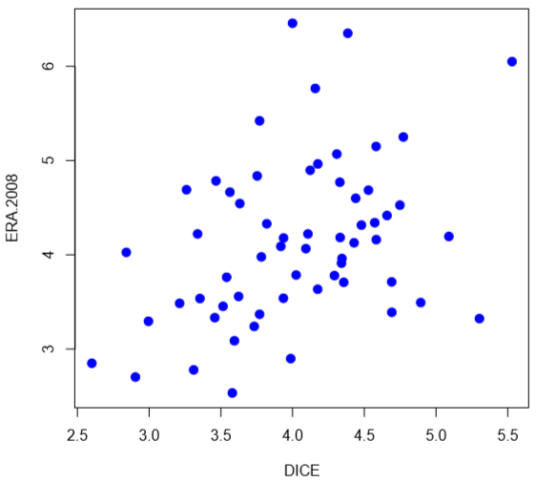
Classic and Modern Metrics
W = Win
L = Loss
ER = Earned Run
IP = Innings
K = Strikeout
HR =Home Run
BB = Walk
HBP = Hit by Pitch
Measuring Pitching

Slide 12


Classic and Modern Metrics
PO = Put-out
A = Assists
E = Errors
Measuring Fielding
Fielding Percentage (FLD%)
Range Factor (RF)
Omar Vizquel and Derek Jeter
$$FLD\%= \frac{PO+A}{PO+A+E}$$
$$RF=9×\frac{PO+A}{IP}$$

Slide 13
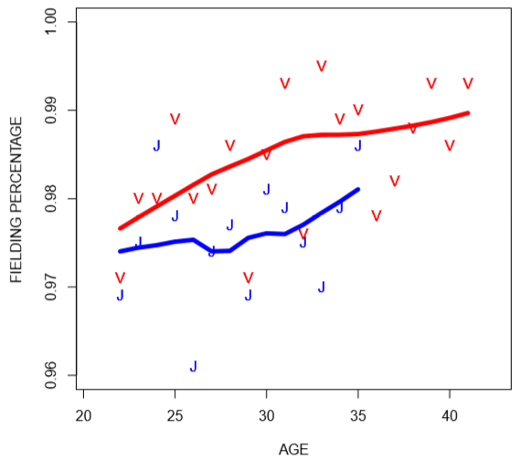
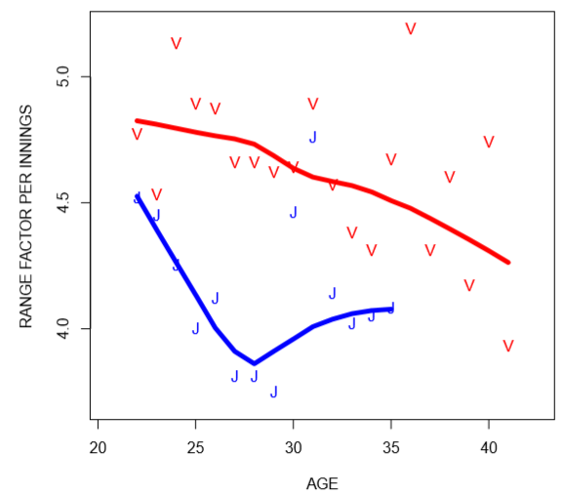
Classic and Modern Metrics
PO = Put-out
A = Assists
E = Errors
Measuring Fielding
Omar Vizquel and Derek Jeter
Omar (9 Golden Gloves)
Derek (3 Golden Gloves)

Slide 14



Pythagorean Theorem
WP = Win %
RS = Runs Scored
RA = Runs Allowed
Classic Pythagorean Theorem
Relationship Between the Sides of a Right Triangle
$a^{2}=b^{2}+c^{2}$
What is Known: More Runs = More Wins
Relationship Between Runs and Wins?
Bill James’ Pythagorean Method
Example: Kansas City in 2014 World Series
651 Runs Scored
624 Runs Allowed
$$WP≈ \frac{RS^{2}}{RS^{2}+RA^{2}}$$
$$89 Wins≈162× \frac{651^{2}}{651^{2}+624^{2}}=84.43$$

Slide 15



Pythagorean Theorem
WP = Win %
RS = Runs Scored
RA = Runs Allowed
Optimization of Relationship
What is the Best Choice of α?
Minimization of Sum of Squared Errors
Optimal: $α=1.82$
Alternative Expression
Useful for Forecasting Playoff Series Winners
Pythagorean Method: 53.8% Accurate
Games Won Approach: 50% Accurate
$$WP= \frac{RS^{α}}{RS^{α}+RA^{α}}+ε$$
#Blessed
$$WP= \frac{(R{S/RA)}^{α}}{(R{S/RA)}^{α}+1}+ε$$

Slide 16


Pythagorean Theorem
WP = Win %
RS = Runs Scored
RA = Runs Allowed
Useful for Valuing Players in Trades
Example: Cleveland Indians
Currently: RS=870 and RA=800
Trade Bing Crosby (100 Runs)
For Frank Sinatra (120 Runs)
Difference: +20 Runs
Before Trade:
After Trade:
$$WP≈ \frac{{\left(\frac{870}{800}\right)}^{1.82}}{{\left(\frac{870}{800}\right)}^{1.82}+1}=0.538$$
$$WP≈ \frac{{\left(\frac{890}{800}\right)}^{1.82}}{{\left(\frac{890}{800}\right)}^{1.82}+1}=0.548$$

Slide 17

Final Inspiration
There’s No Crying in Statistics.
- Mahatma Mario

